Slide 1
noIT
Problem Statement:
To create a fun and interactive way of learning basic fundamentals of science through games and visually appealing graphics
Group Name: HUMAN CYBORGS
Group ID: 6106
Members:
Priyansh
Soumya
Pratyush

Slide 2
Problem:
Kids these days play a lot of video games and neglect their studies. If there is a way for teachers to teach them the fundamental concepts in a much more visually appealing way, it would definitely clear out the doubts and build a long lasting impression on the student’s minds.
SOLUTION:
A computer application that enables education to turn into a visual making it way more easier to understand and encourages the child to study the concept while playing a game, which is already an interesting thing for them.

Slide 3
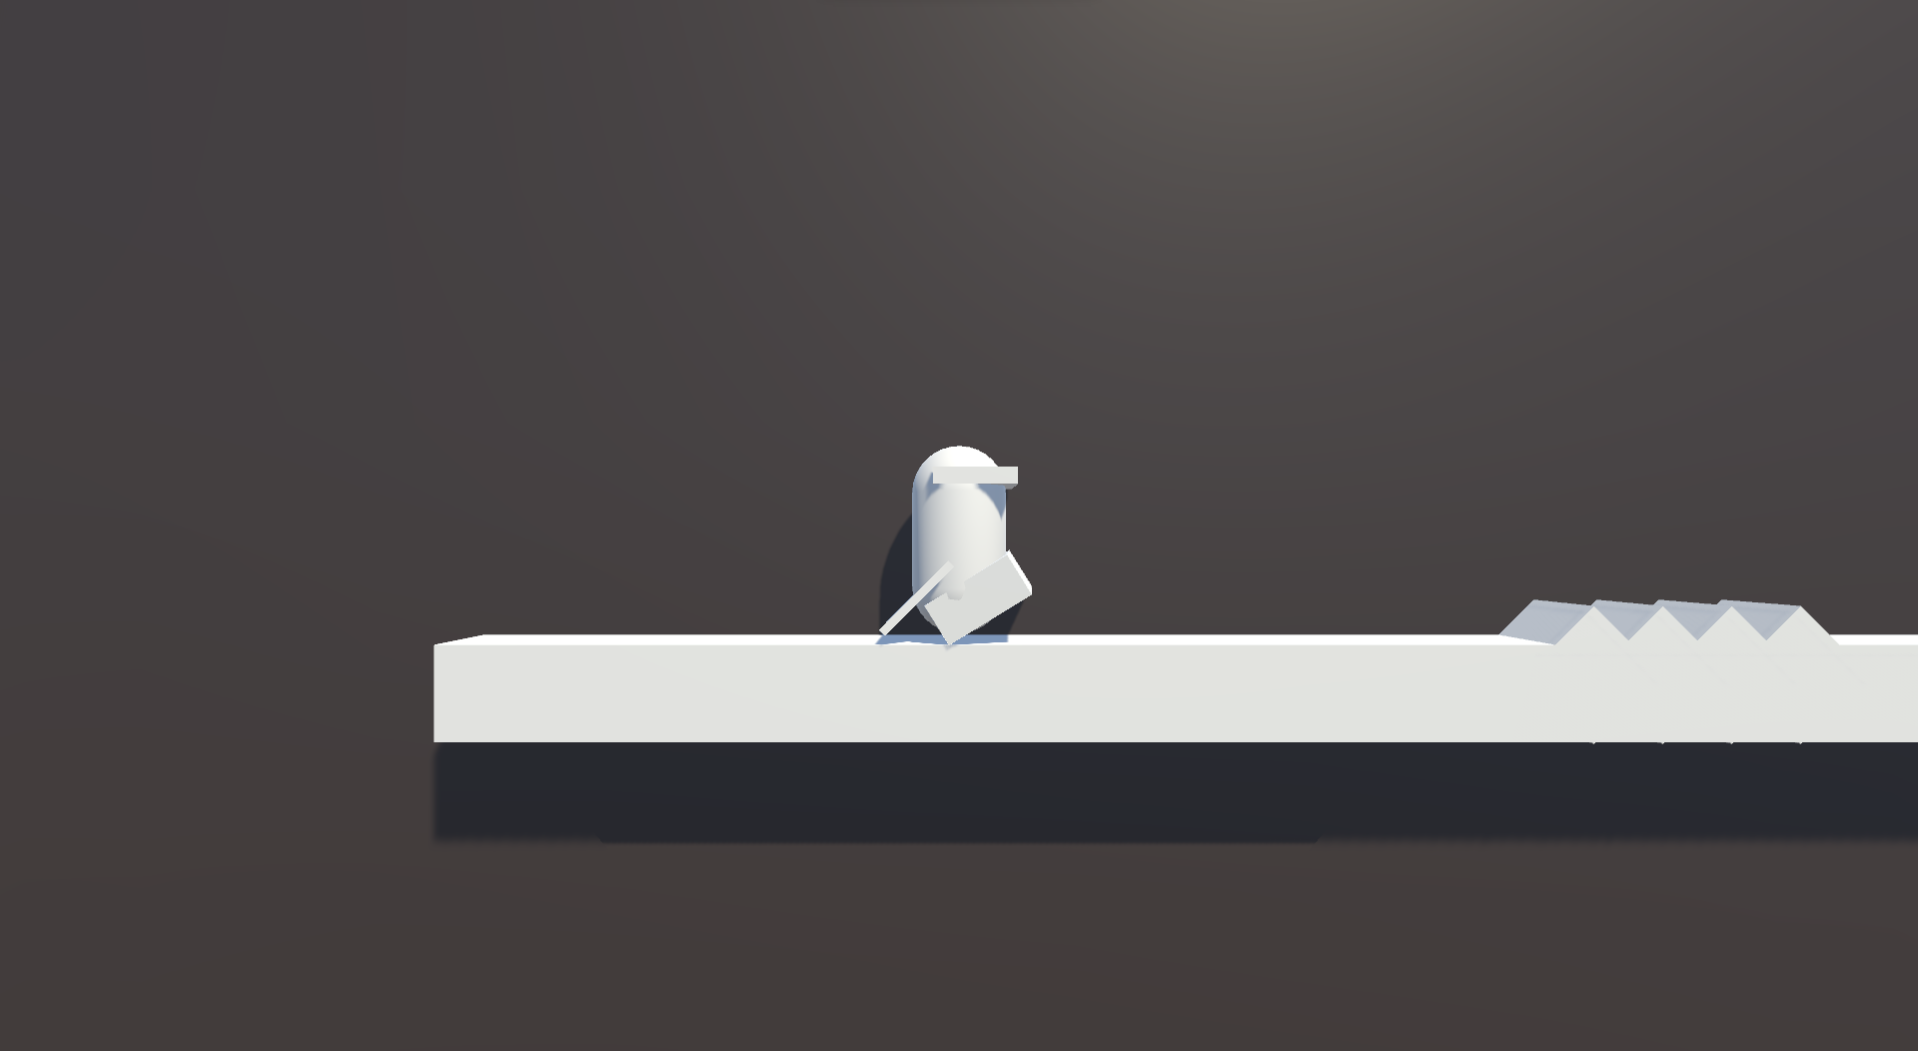
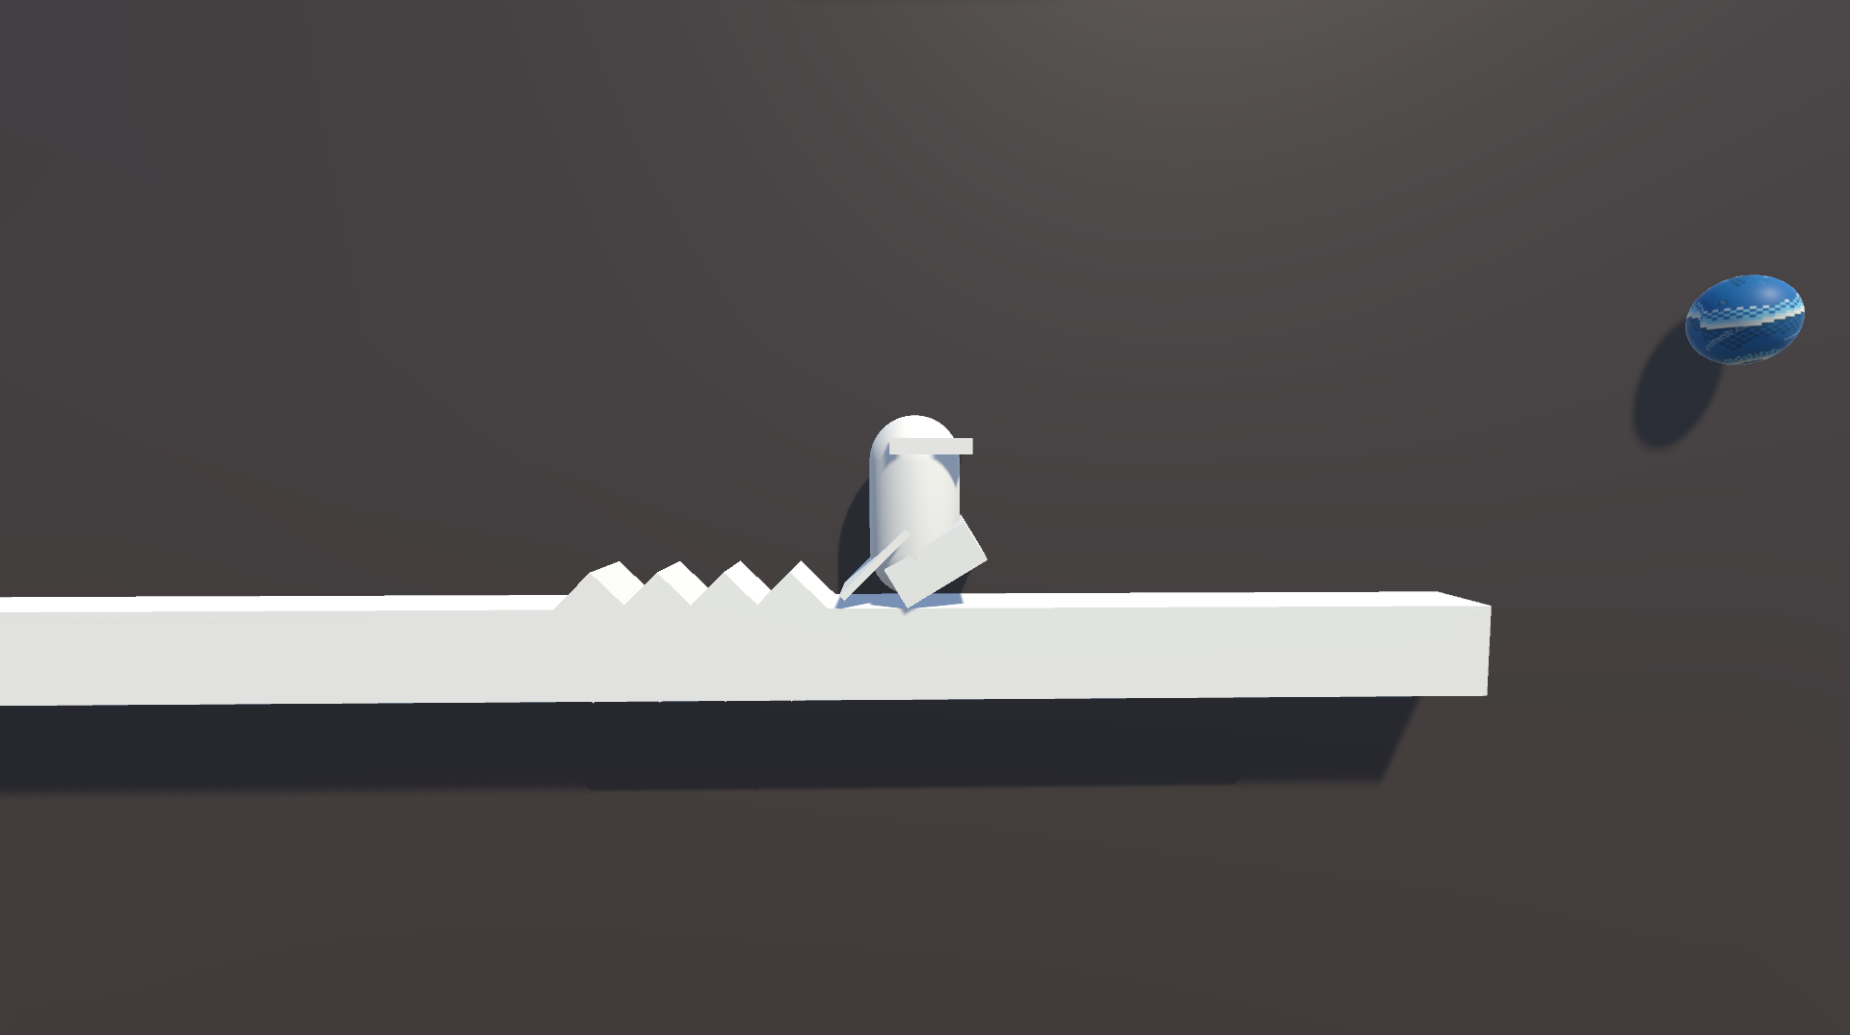
The player starts playing and they need to save themselves from obstacles by jumping :

Slide 4
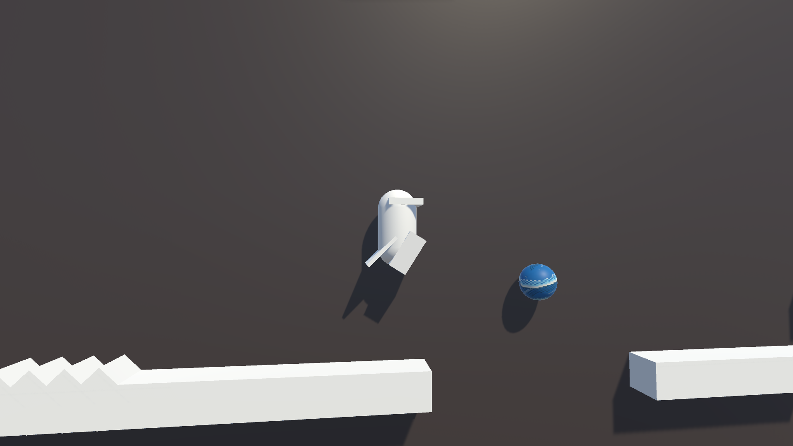
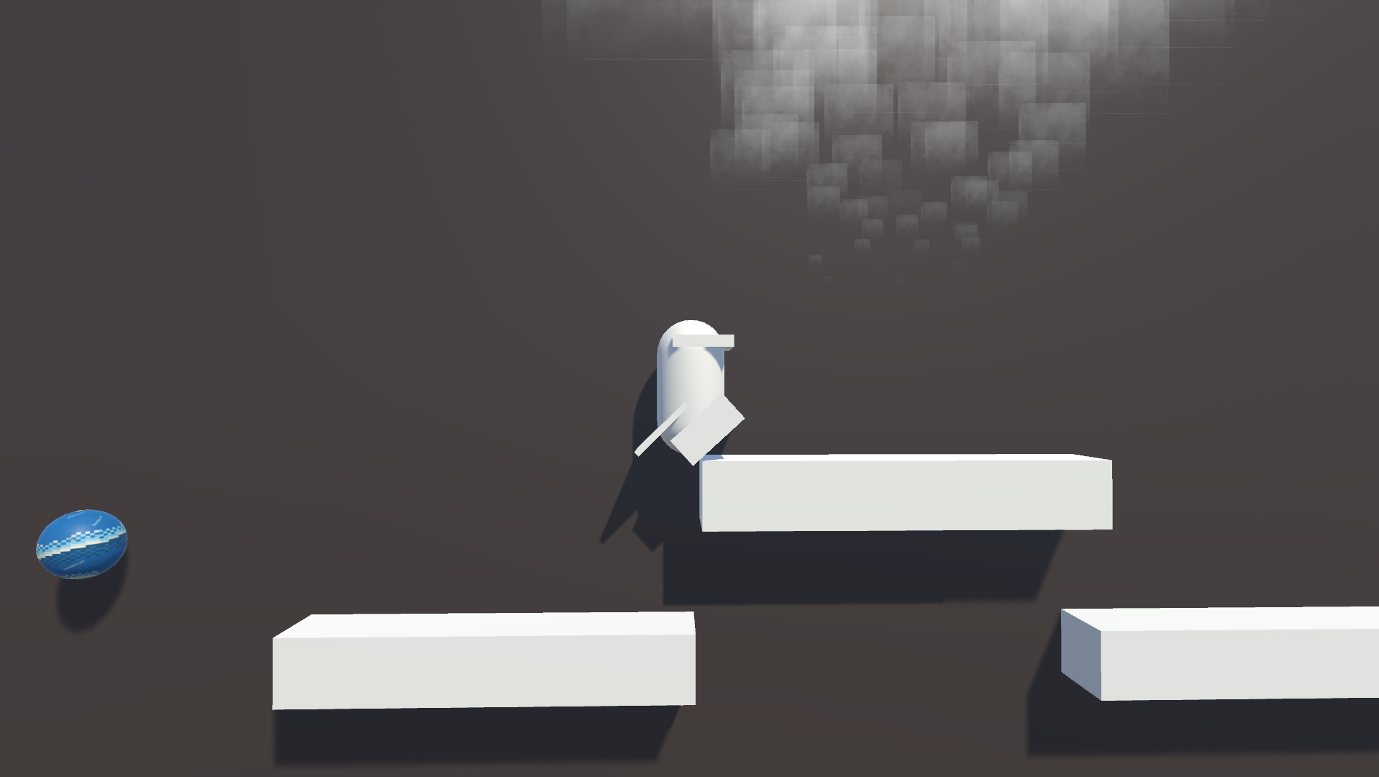
Collect tokens signifying different fundamental concepts :

Slide 5
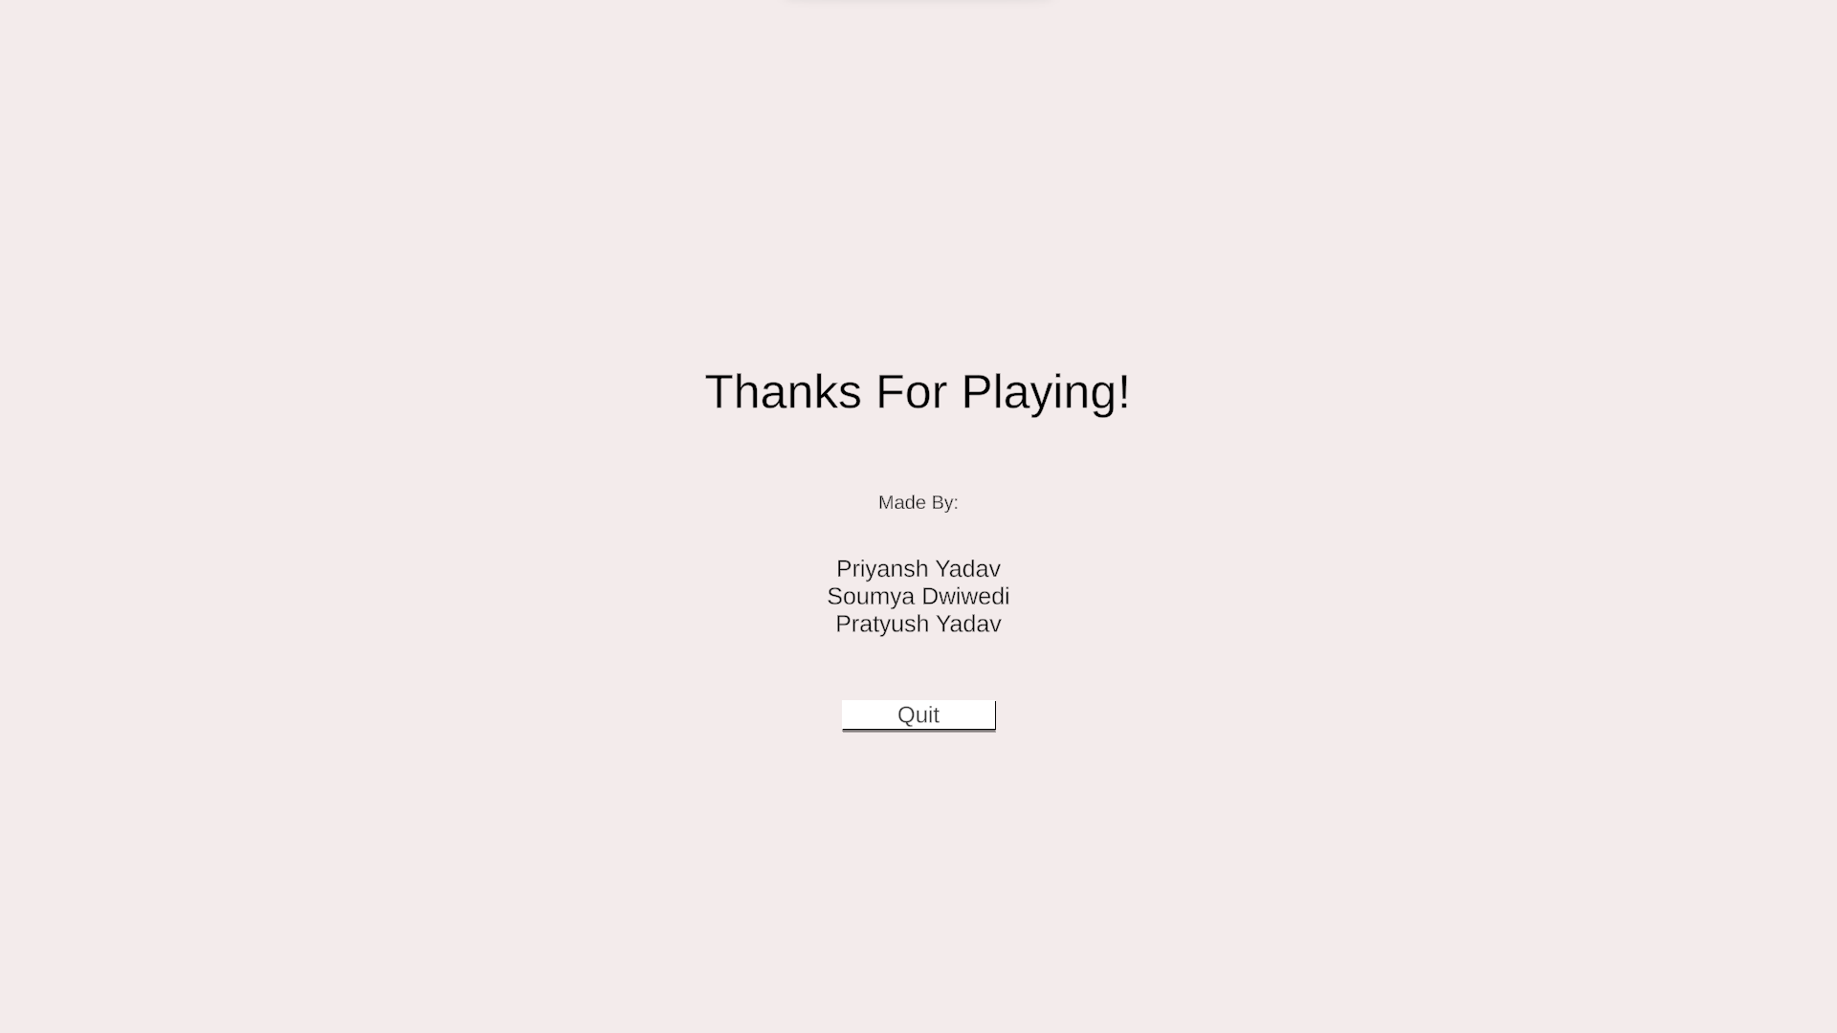
Collect all tokens and win the game

Slide 6


APPLICATIONS USED:
Designed on :
Language used:

Slide 7
Scope of the project :
Schools can access this web application and teach children the concepts easily.
Teachers can personalise the questions and change the topics according to their subject (future scope; when the tokens will be converted into a template).
It is definitely a better way to take quizzes and assignments and HW.

Slide 8
THANK YOU

